Slide 1
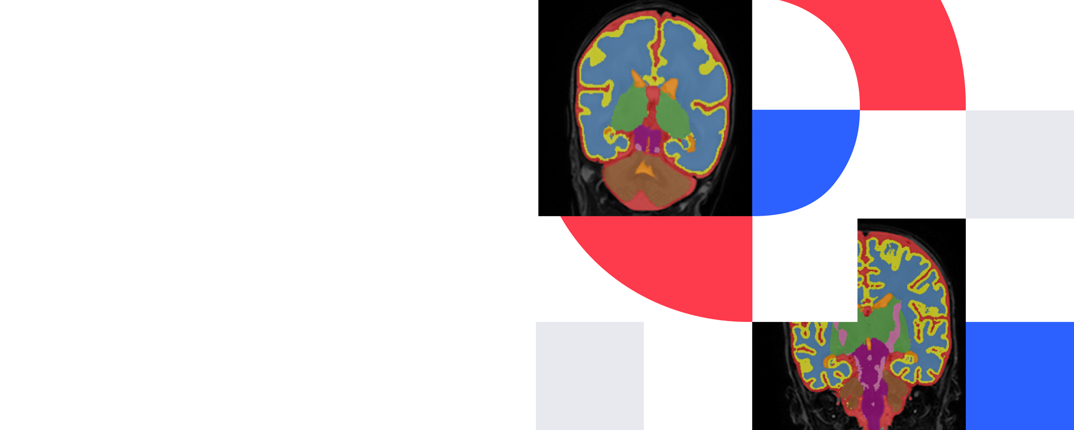

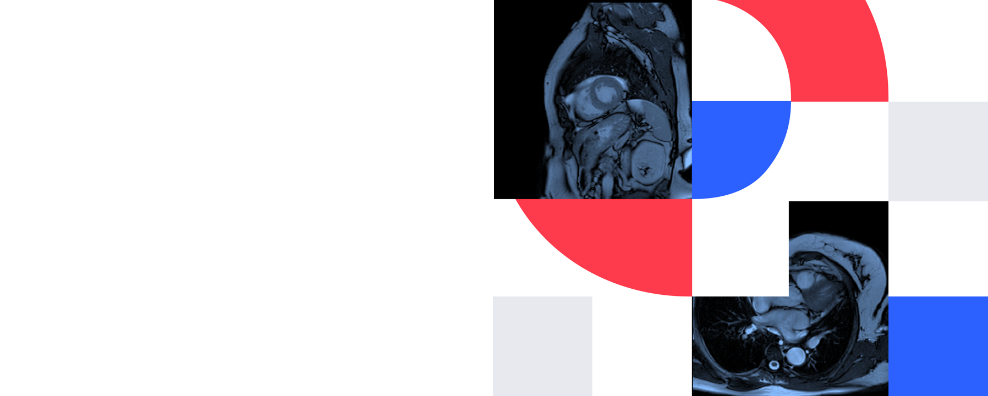


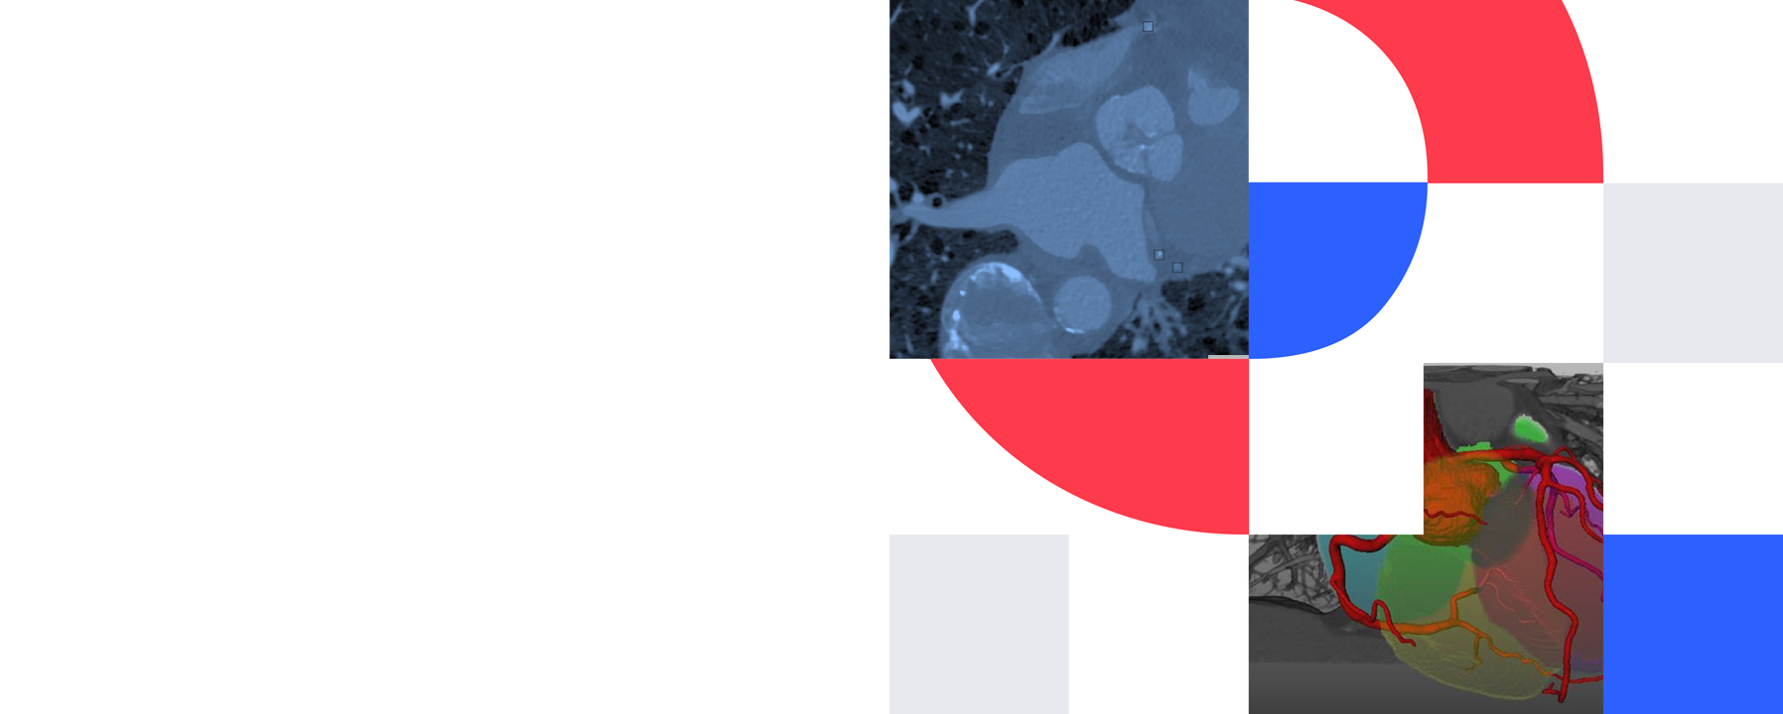
Symmetry and structure in cardiac imaging
Guest lecture, MSc AI medical imaging course
Soufiane Ben Haddou

Slide 2

About me
PhD candidate, third year, Amsterdam UMC
Research: SE(2)-equivariant neural fields for cardiac MRI reconstruction, segmentation and synthesis
MSc: AI, UvA, 2023
BSc: AI, UvA, 2021
Notes:
Keep this to a minute. Say how you got from your bachelor and master to cardiac imaging; the students are deciding on thesis topics, so the route is more useful to them than the titles.

Slide 3
Outline
Challenges: what makes cardiac MRI hard for deep learning
Other projects: cardiac motion and strain, shape from neural fields
My direction: equivariant neural fields, and generating images with masks
Equivariance: building rotation and translation into the network
Notes:
One idea runs through the lecture: put what you already know about the data into the model instead of hoping it learns it from few labels. Each part is one example of that.

Slide 4
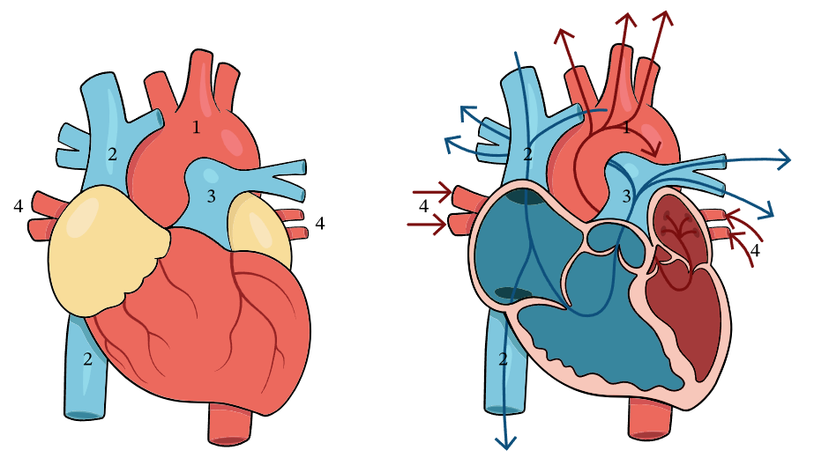
Heart Anatomy
Notes:
Medical image analysis has witnessed a growing adoption of AI-based techniques to support clinical decisions on diverse tasks, such as patient diagnosis, risk stratification, prognostic assessment and treatment planning.
Deep Neural networks are considered black-box models due to the lack of inherent interpretability and explainability provided by their highly complex non-linear nature. Consequently, their
insufficient transparency may affect their clinical adoption.
Hence, providing insights into decision-making understandable to clinicians is currently an area of intensive research.
Understanding how and why AI models make specific predictions is crucial to introduce trustworthiness into medical AI-driven applications.

Slide 5
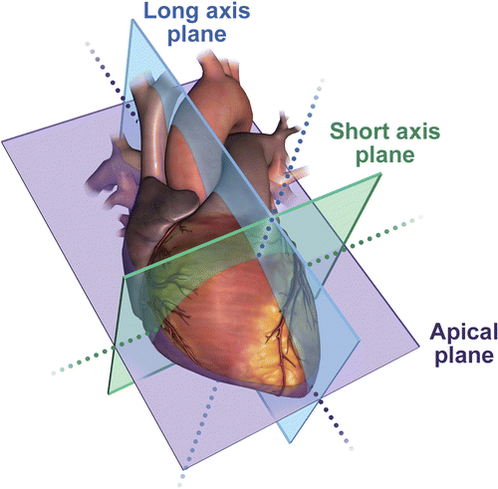
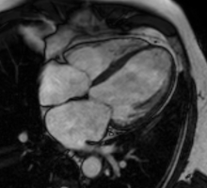
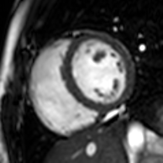

Slide 6
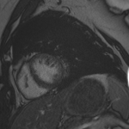
Cardiac MRI: slices of a beating heart
Cine MRI: a stack of short-axis slices, each imaged over the full cardiac cycle
Left ventricle, right ventricle and myocardium are visible in each slice
Slices are several millimetres thick, much coarser than the in-plane resolution
Late gadolinium enhancement (LGE) adds contrast for scar and fibrosis
Cine MRI
Notes:
Explain short-axis orientation and cine acquisition. Point at LV, RV and myocardium on the figure. Mention that through-plane resolution is much coarser than in-plane; this comes back when we talk about neural fields.

Slide 7
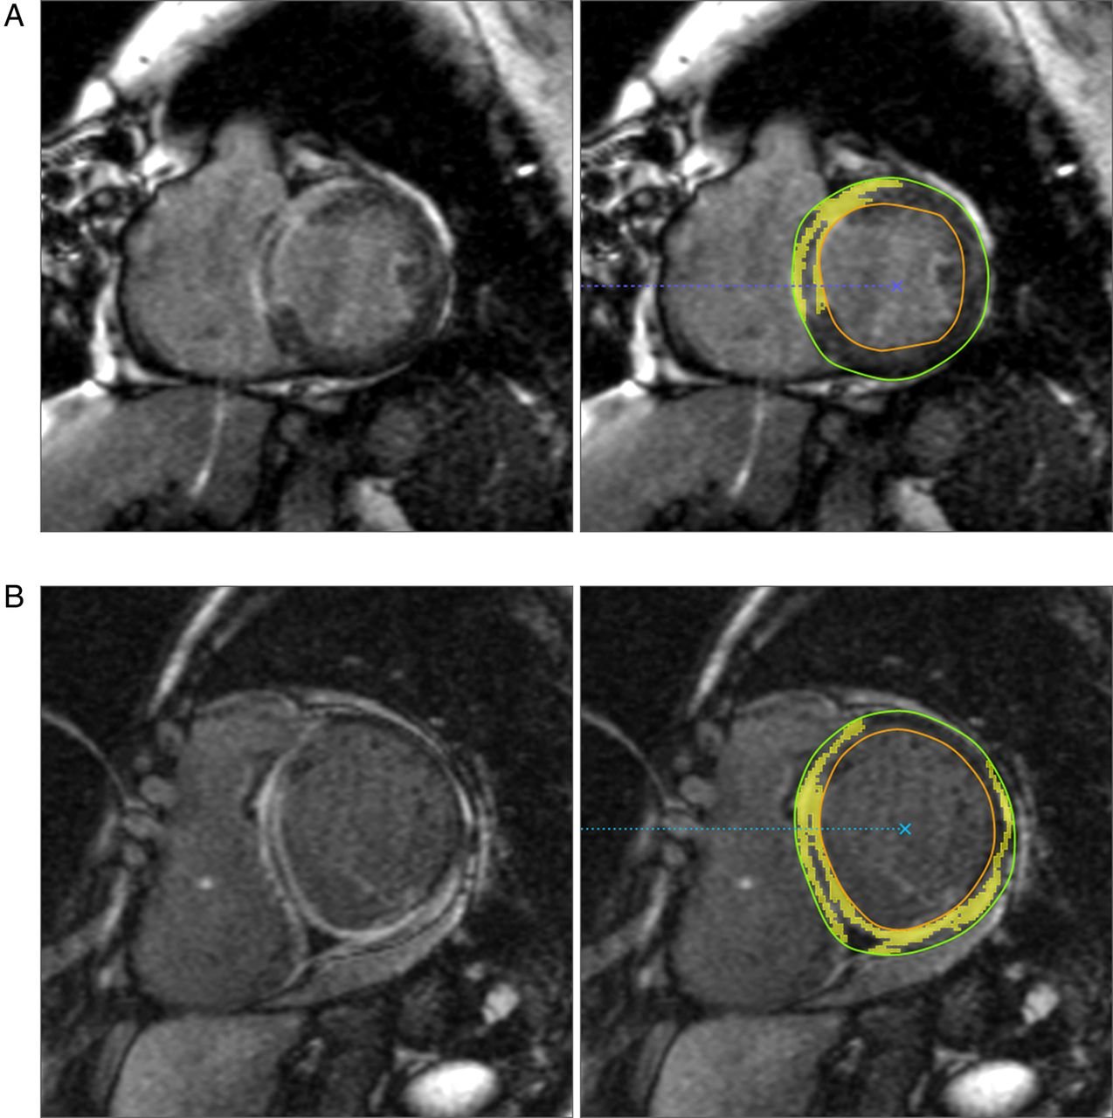
Cardiac MRI: slices of a beating heart
Cine MRI: a stack of short-axis slices, each imaged over the full cardiac cycle
Left ventricle, right ventricle and myocardium are visible in each slice
Slices are several millimetres thick, much coarser than the in-plane resolution
Late gadolinium enhancement (LGE) adds contrast for scar and fibrosis
LGE MRI
Notes:
Explain short-axis orientation and cine acquisition. Point at LV, RV and myocardium on the figure. Mention that through-plane resolution is much coarser than in-plane; this comes back when we talk about neural fields.

Slide 8
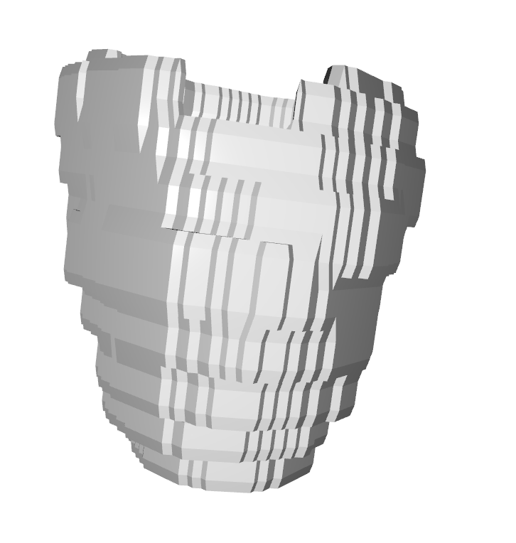
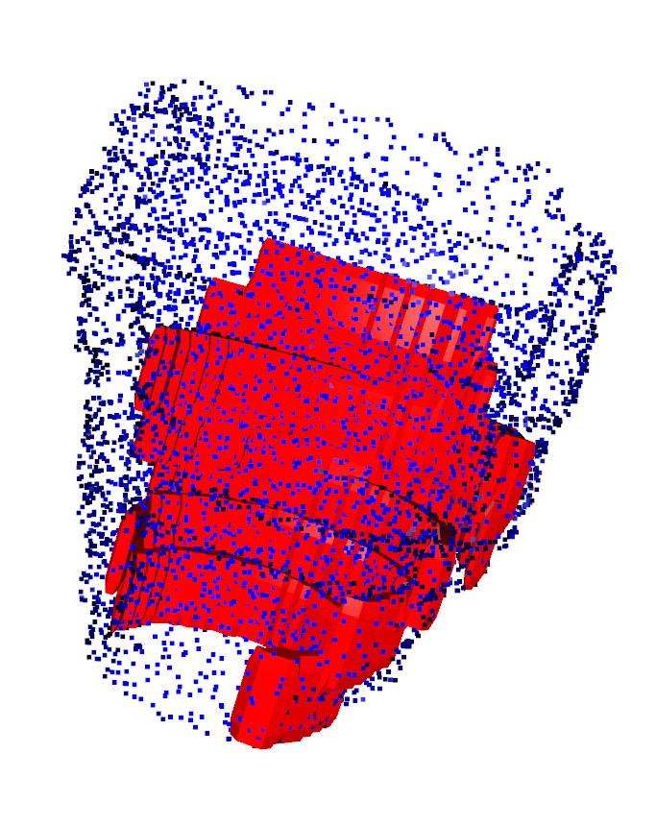
From images to clinical numbers
Segment LV cavity, myocardium and RV at end-diastole and end-systole
The volumes give ejection fraction, the main measure of pump function
Myocardial mass and wall thickness come from the same masks
Quantifying fibrosis on LGE needs a myocardium mask first
Manual contouring is slow and differs between observers
LGE mesh
Fibrosis mesh
Notes:
Why segmentation matters clinically: the numbers a cardiologist uses come from the masks. Ask the room how long they think one manual contouring session takes.

Slide 9
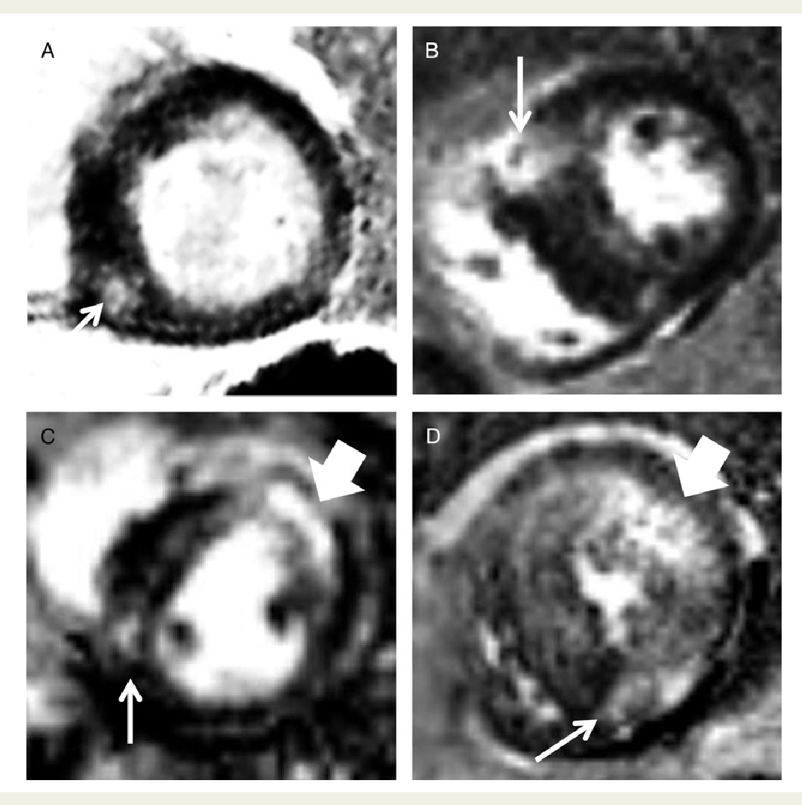
Challenges in cardiac imaging
Low data: every mask costs expert time. ACDC has 150 patients; LGE scar annotations are scarcer and harder to agree on
Arbitrary pose: the heart sits at a different position and angle in every scan
Texture: scar and fibrosis in LGE are small, diffuse intensity patterns that are easy to blur away
Motion: cine MRI is a moving image. Frames are samples of one repeating cycle, not independent images
Notes:
Four challenges, each tied to something we know in advance about the data. Low data and texture are mostly an LGE story; motion is the cine story. ACDC has 100 training and 50 test patients. Variable resolution and slice spacing between scanners is a fifth challenge worth a sentence here: it comes back in the neural fields part. Paste the LGE and cine examples from your other presentation on this slide.

Slide 10
We know more than the network does
What we know | Standard approach | Building it in
The heartbeat is periodic | Classify each frame separately | Phase on a circle (CyclePhase)
Anatomy is continuous | Fixed pixel grid | Neural fields
Pose is arbitrary | Rotation augmentation | SE(2)-equivariant networks
Image and mask belong together | Label every image by hand | Generate both from one latent
Notes:
This table is the map of the lecture. Read it row by row: what we know, what the default approach does with that knowledge (nothing), and what we can do instead. Come back to it at the end.

Slide 11
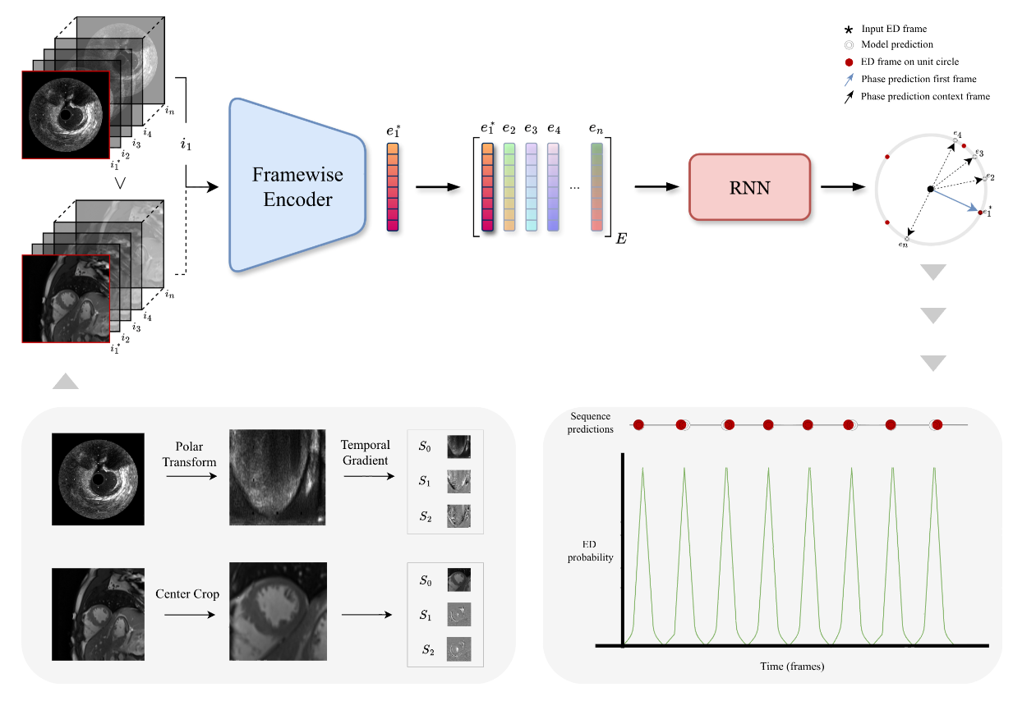
Finding end-diastole in a sequence
Many analyses start from the end-diastolic (ED) frame of an image sequence
Usual formulation: classify each frame as ED or not ED
That target is sparse: only a few frames per sequence are positive
It ignores that every frame in between has a position in the cycle
Notes:
Set up the CyclePhase problem. TO CHECK: name the modalities and datasets from the paper here, and say why ED detection is needed for them.

Slide 12
CyclePhase: put the phase on a circle
Represent cardiac phase as a point (cos φ, sin φ) on the unit circle
Frame-wise ResNet encoder followed by a recurrent temporal decoder
Multi-objective loss: ED classification plus phase regression on the circle
Every frame carries supervision, and the output is periodic by construction
Add figure: phase latents on the unit circle (MIDL paper)
Notes:
Key point: changing the output representation, not the backbone, encodes the periodicity. TO CHECK: loss terms and headline results against the paper, and add the main number with its baseline.

Slide 13
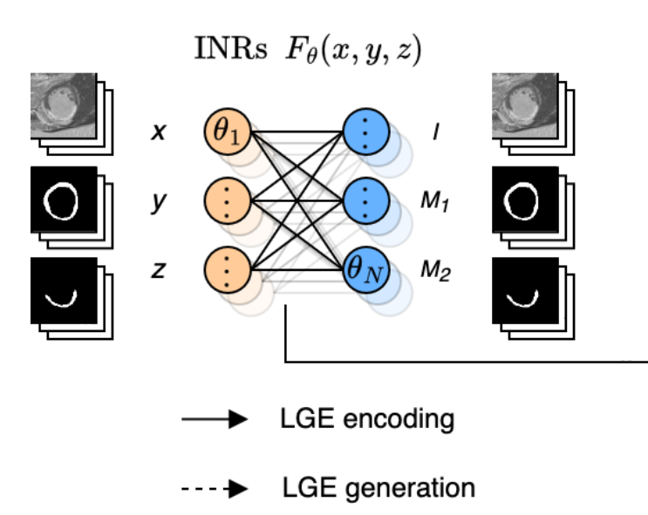
An image as a function, not a grid
A neural field is a network f(x, y) that returns the intensity at any coordinate
Resolution is a choice at query time, not a property of the model
The same field can output intensity and a segmentation at each point
Fourier features or sine activations are needed to capture fine detail
Notes:
Introduce neural fields from scratch; most students know NeRF by name. Connect resolution independence back to the anisotropic sampling of cardiac MRI. Spectral bias is the reason for Fourier features and SIREN.

Slide 14
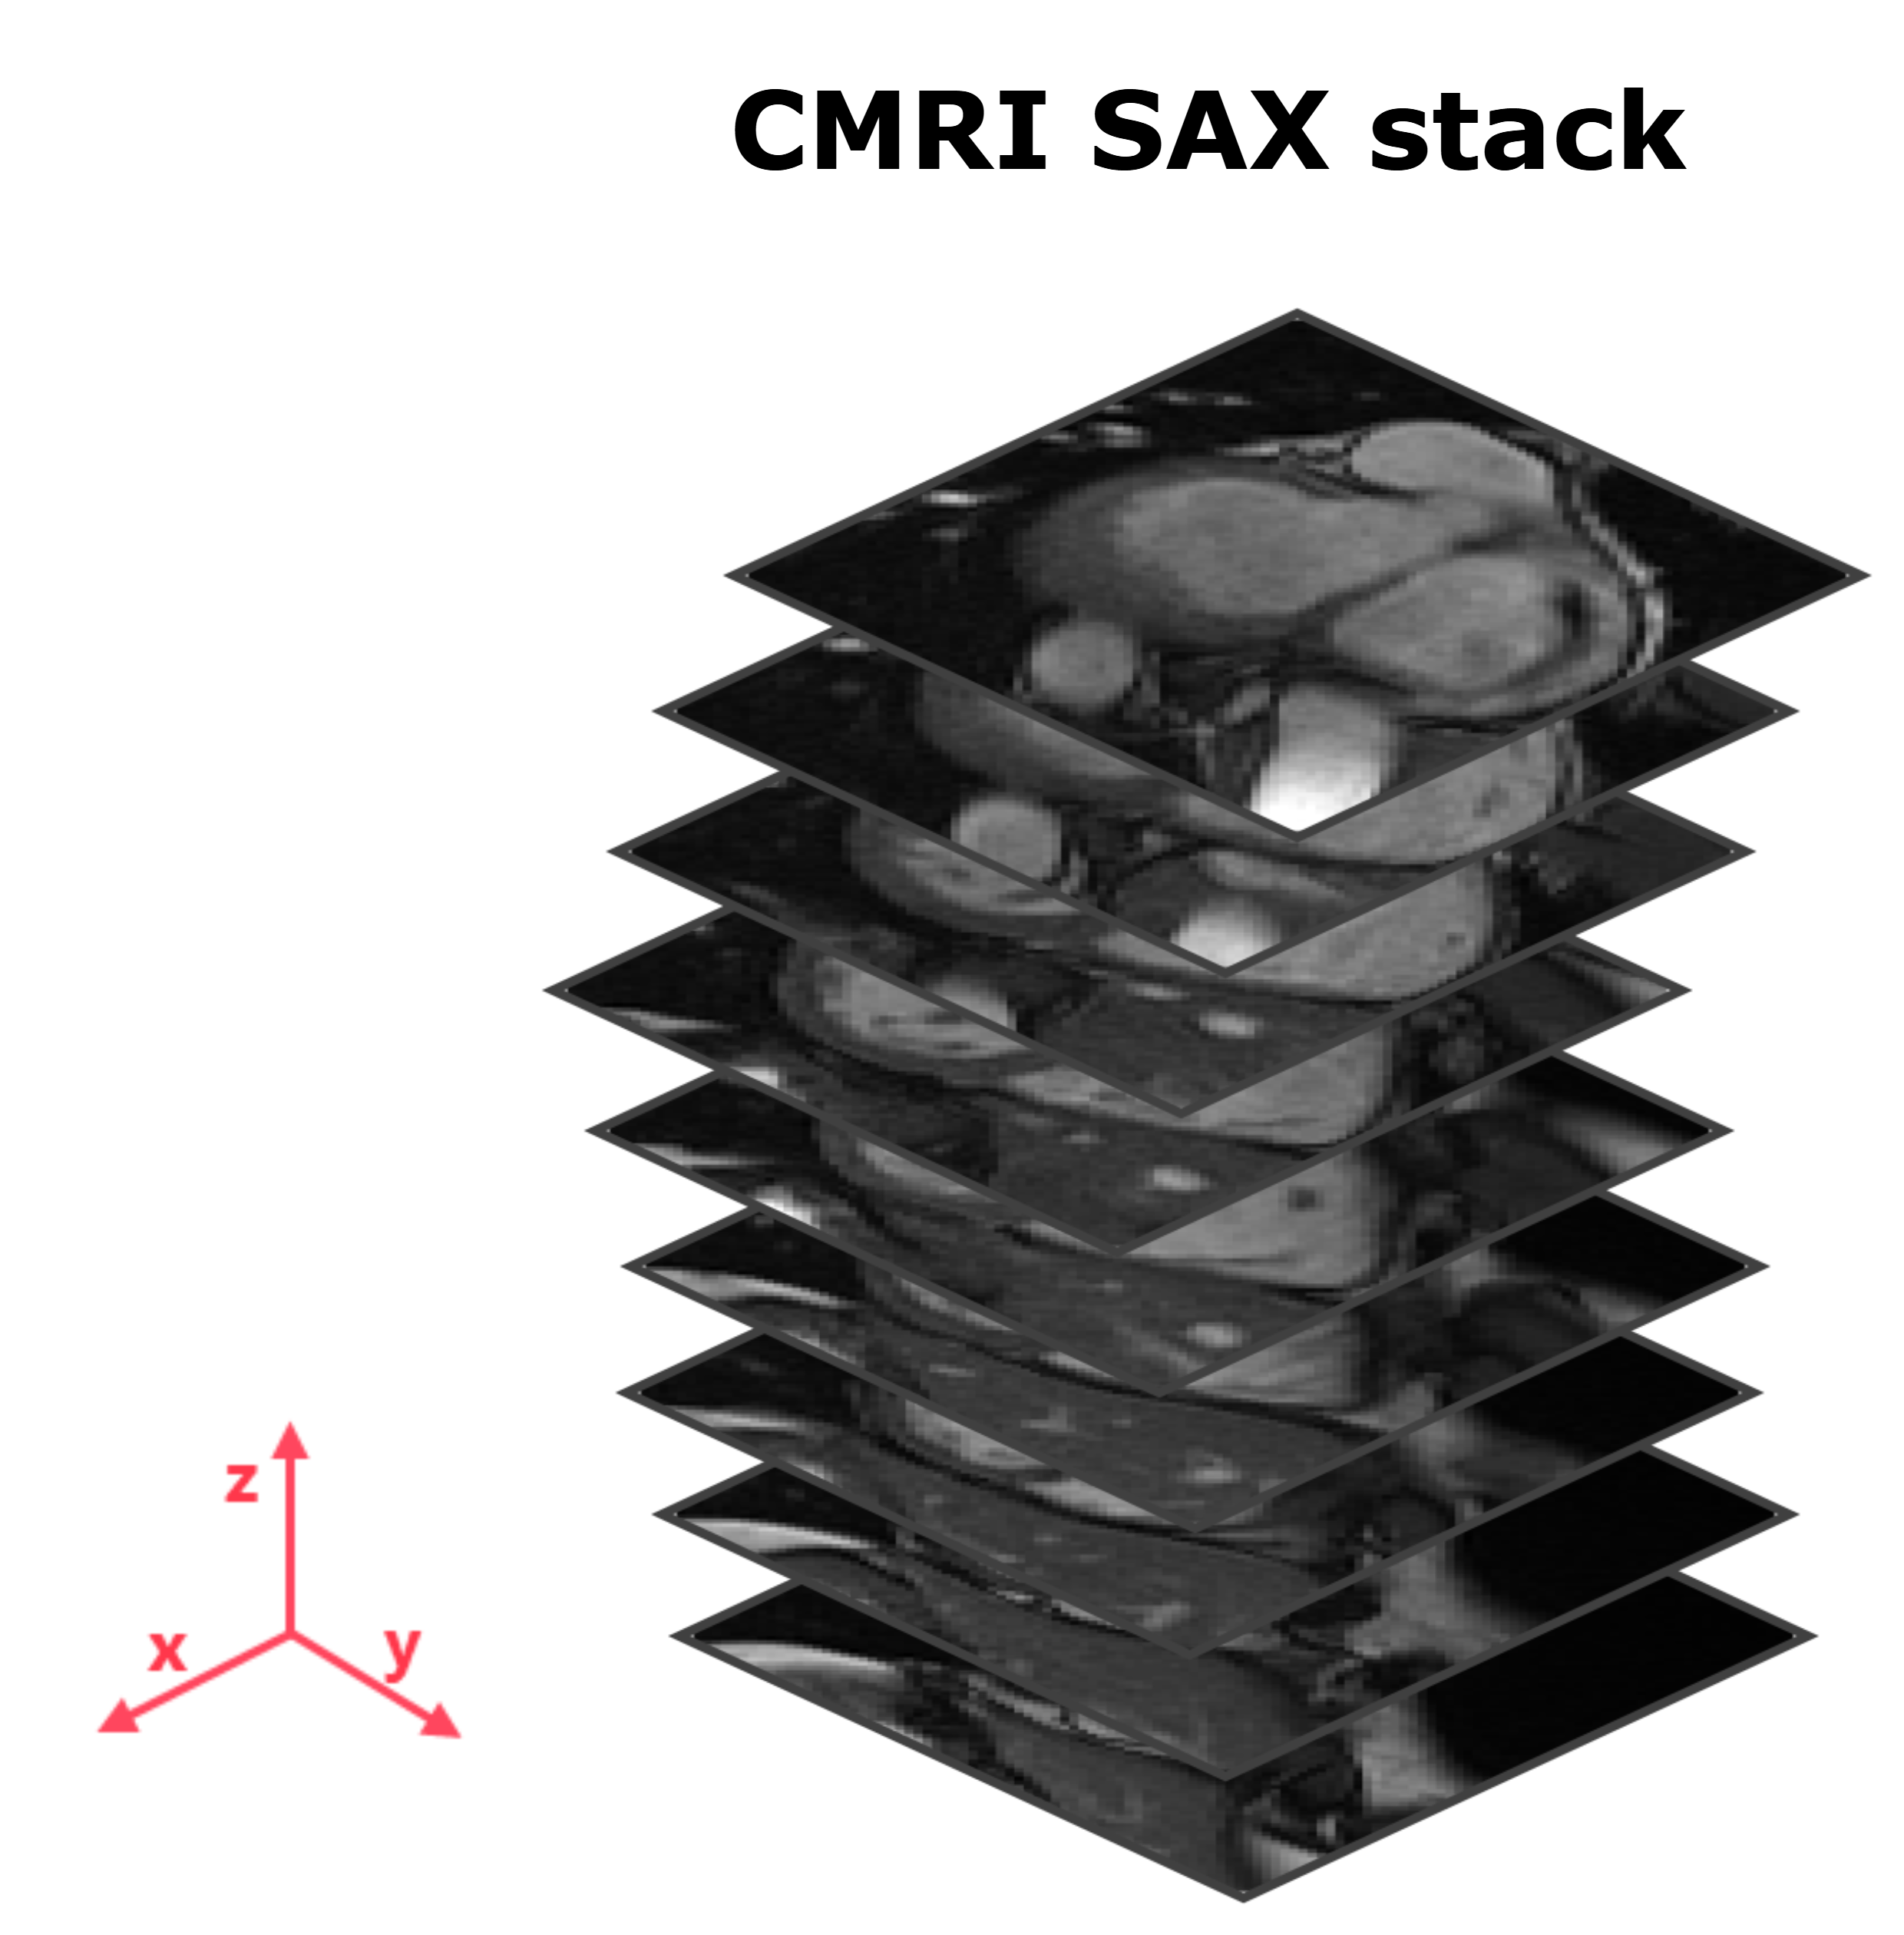
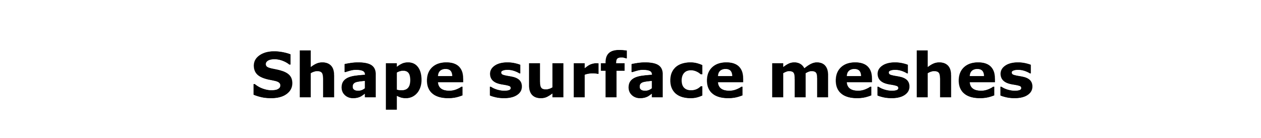
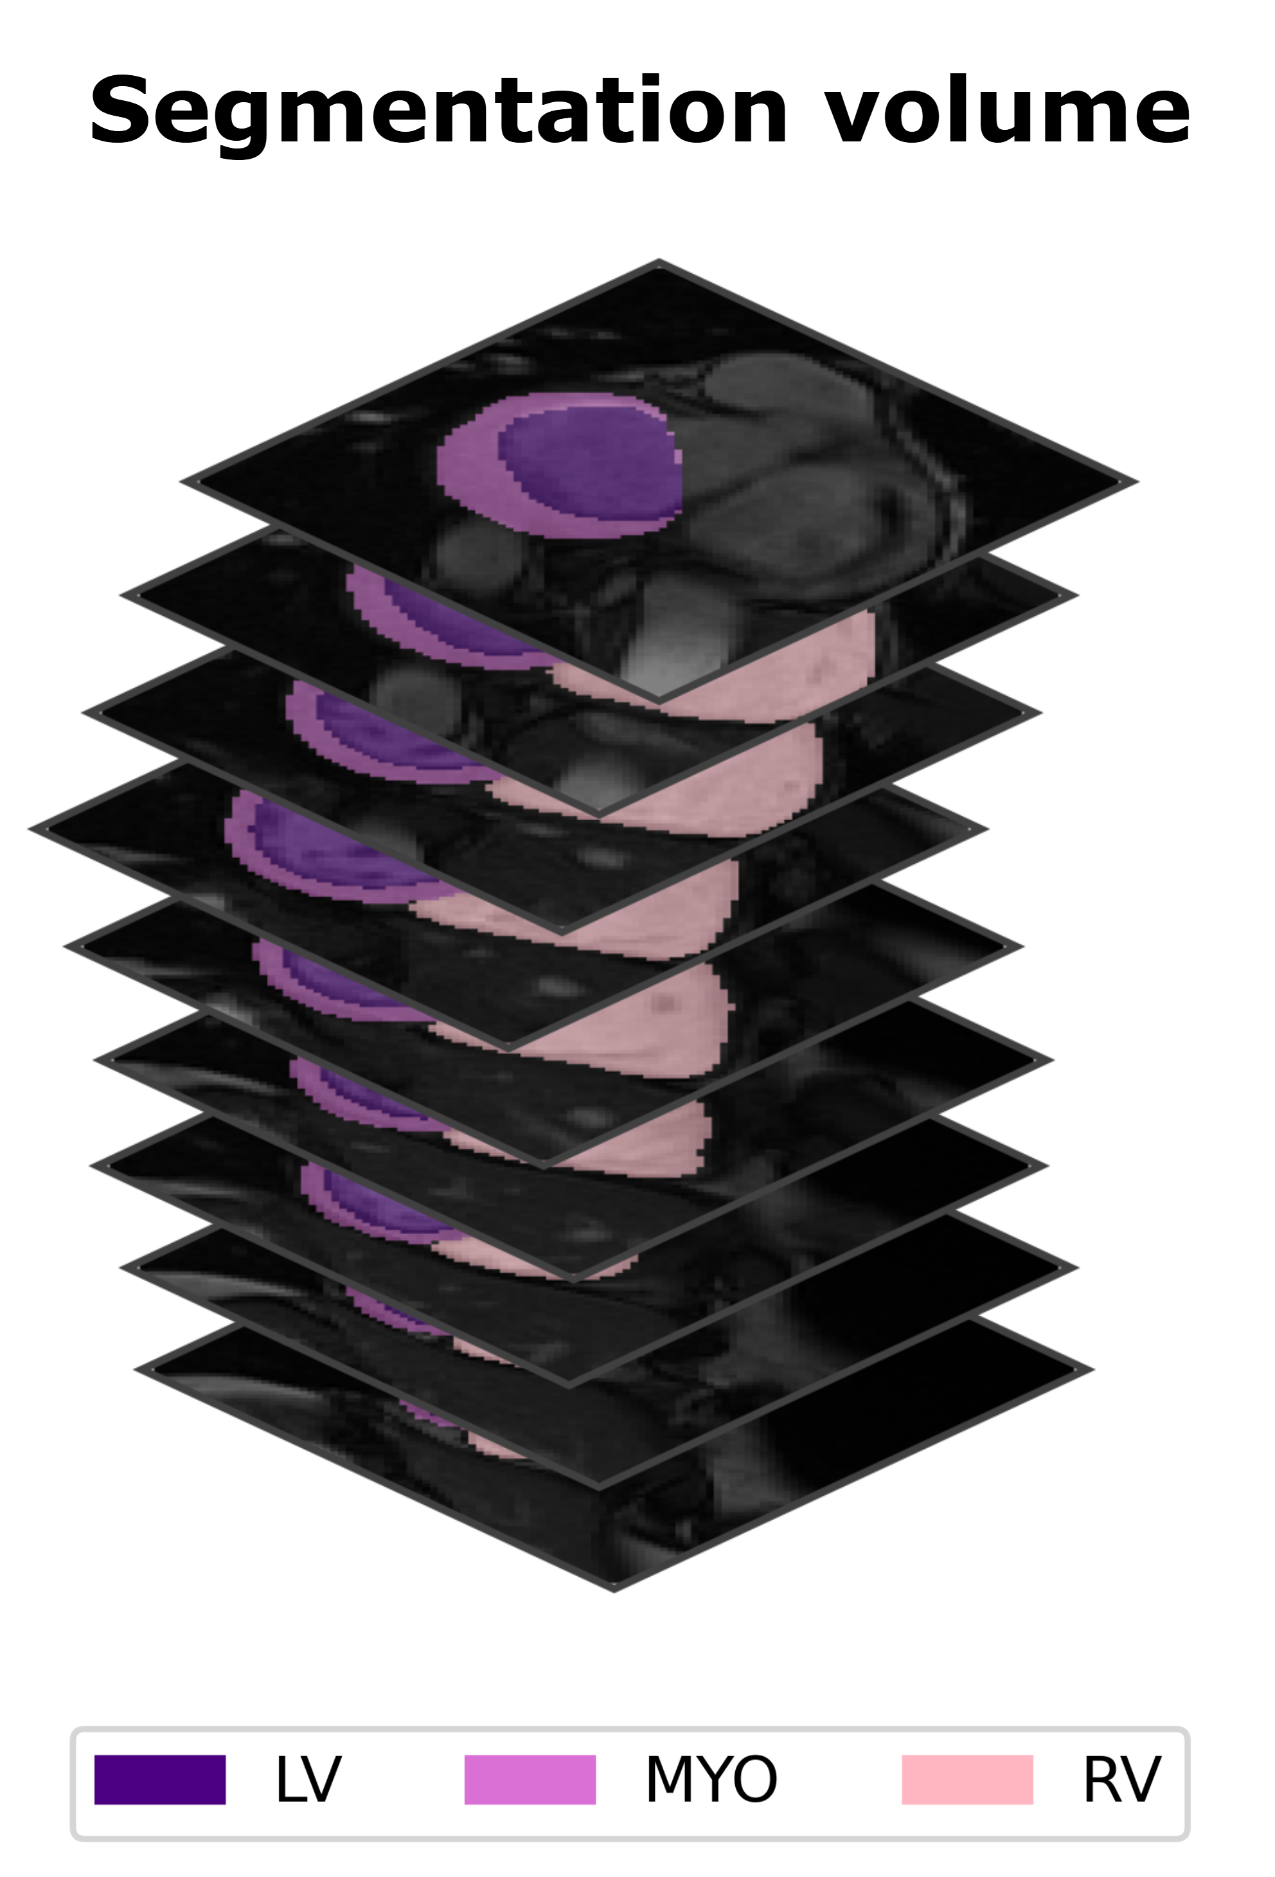
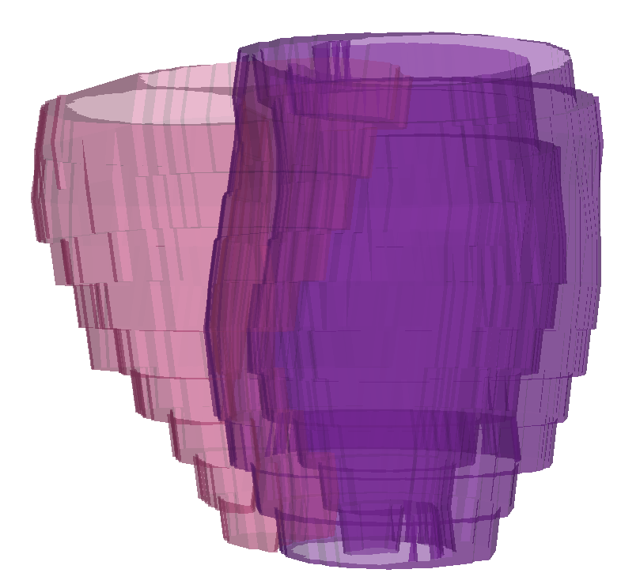


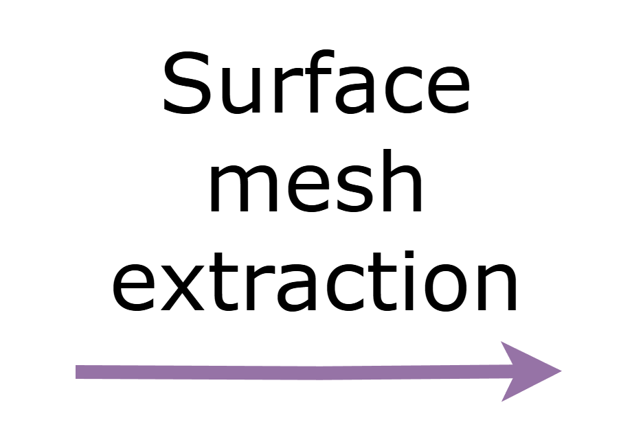
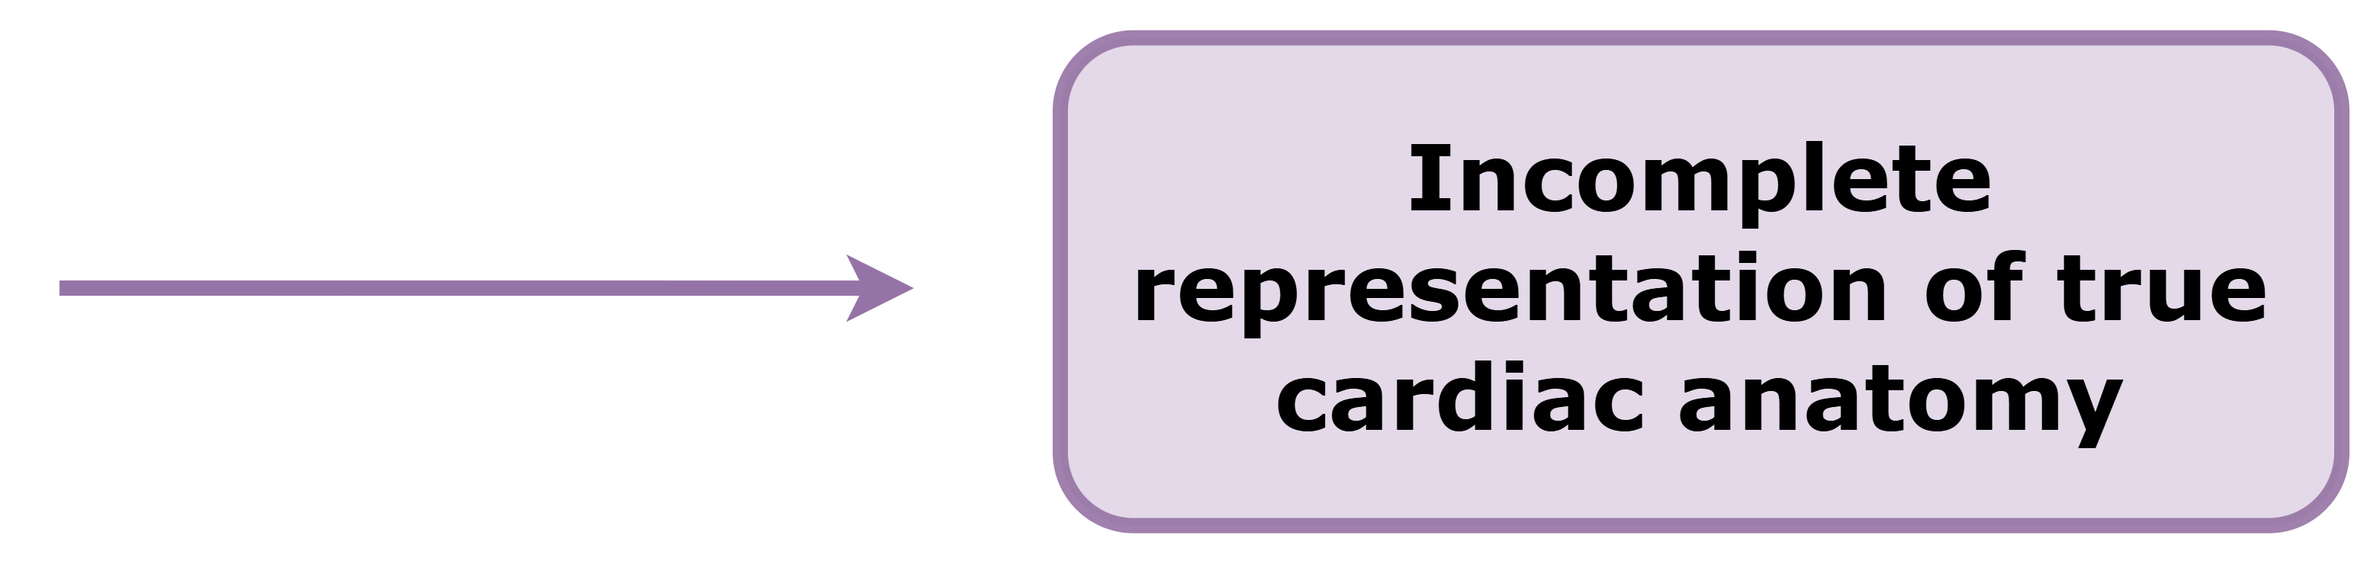
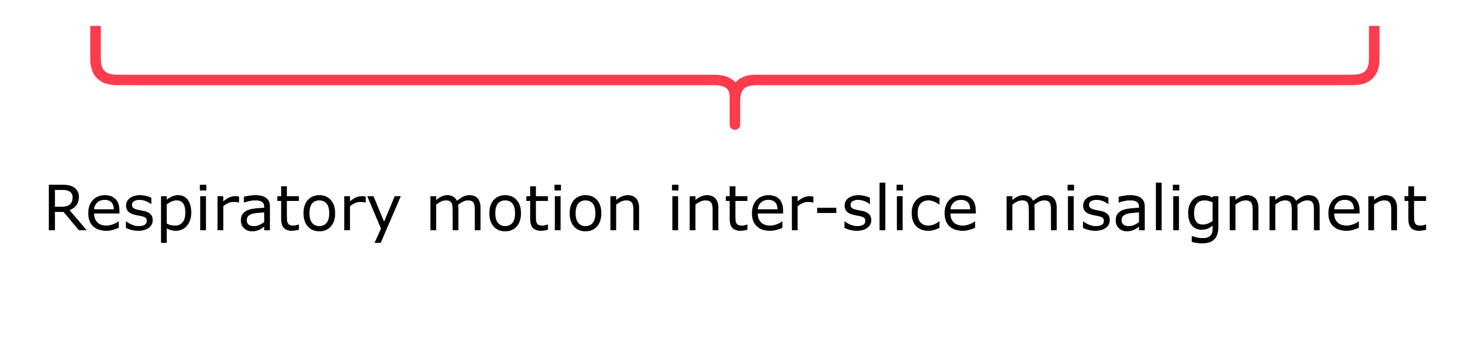
Example (Bras, et al. 2026)

Slide 15
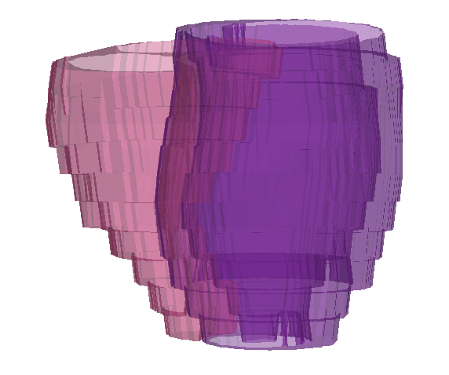
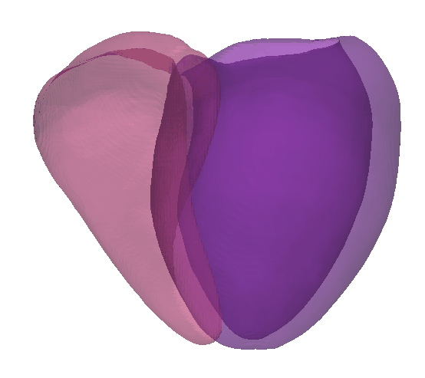
Example (Bras, et al. 2026)
Low-resolution, anisotropic
cardiac shapes
High-resolution, nearly isotropic cardiac shapes
?
Optimal representation of true cardiac anatomy

Slide 16
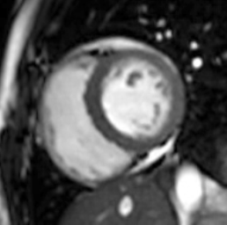
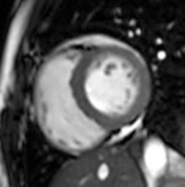
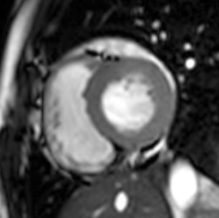
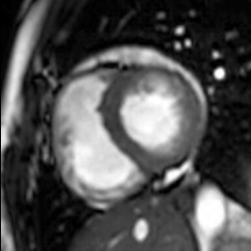
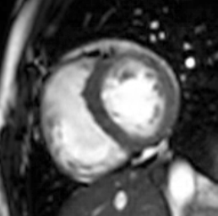
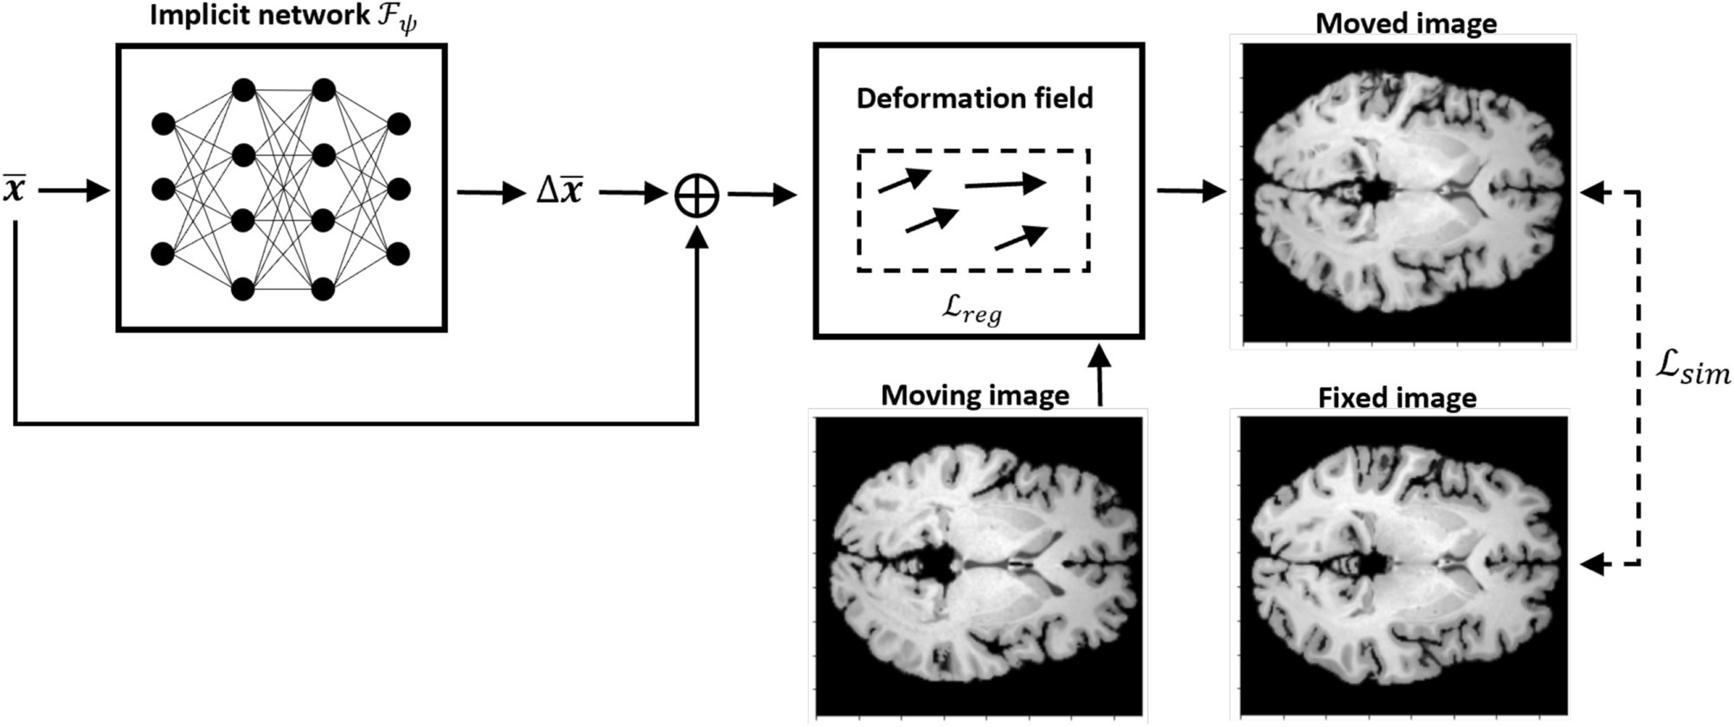
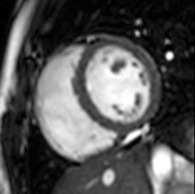
INR for motion assessment
Example (Alvarez, et al. 2026)
4D cine volume
4D cine volume
X2
Image similarity loss
X1
t19
t1
X50
t7
Coordinates and time are input to the network
+
Warped sequence
Fixed image

Slide 17
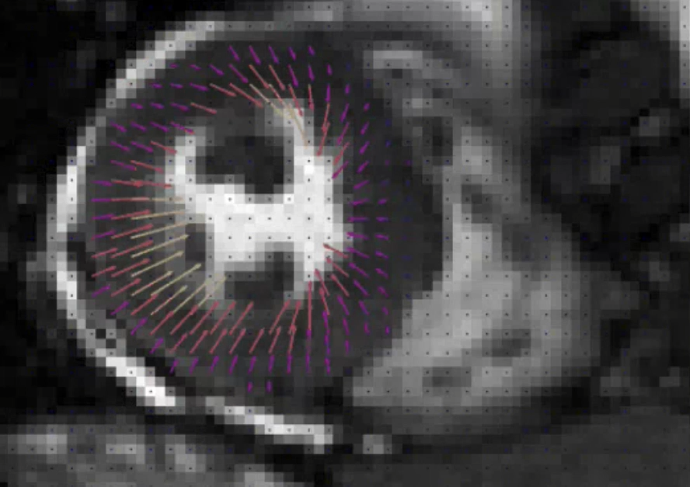
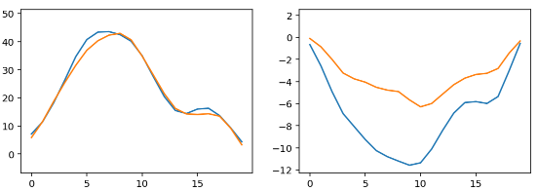
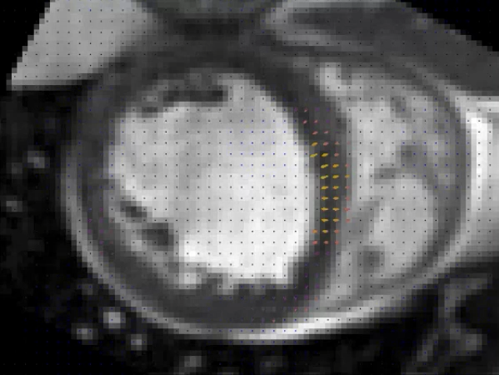
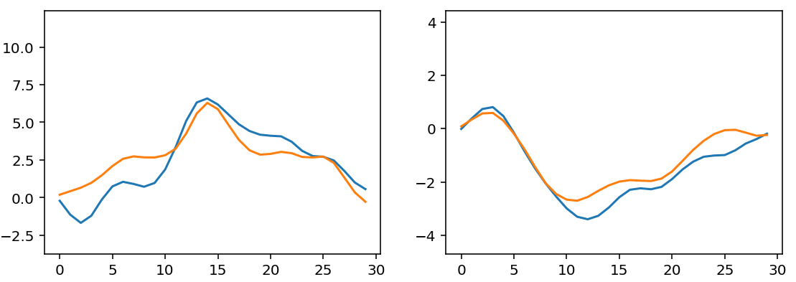
Displacement for controls and CRT
Control subject
circumferential
radial strain
endocardium
epicardium
CRTD subject
radial strain
circumferential

Slide 18
What about LGEs?
Notes:
Back to the label problem from the start. Because image and mask come from one latent, each sample is a labelled pair. Show samples and, if available, the downstream segmentation result with and without synthetic data.

Slide 19
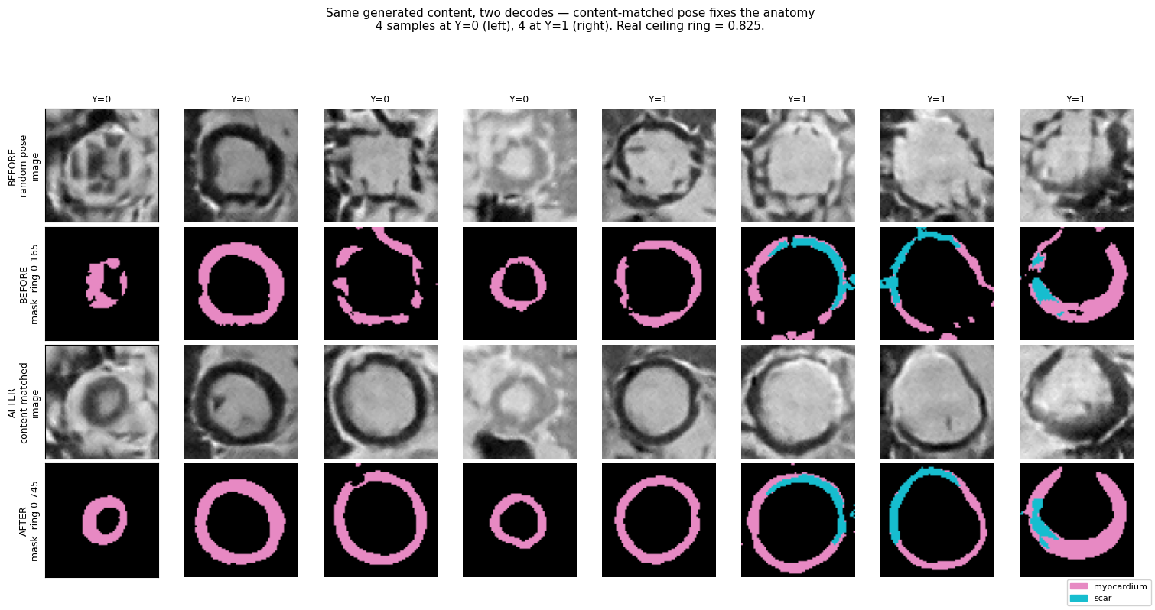
Generating images with their masks
Train a diffusion model on the latents instead of on pixels
Decode each sampled latent into an image and its mask
The pairs are extra labelled data for a segmentation network
Aimed at structures with few labels, such as myocardium and fibrosis
Notes:
Back to the label problem from the start. Because image and mask come from one latent, each sample is a labelled pair. Show samples and, if available, the downstream segmentation result with and without synthetic data.

Slide 20
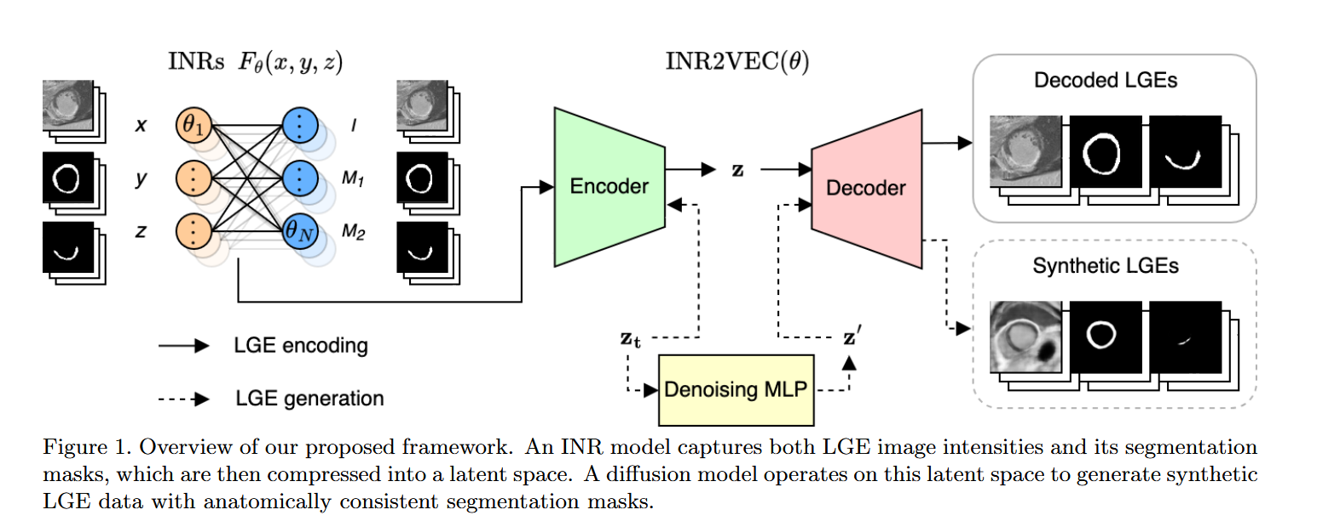
Example
Fit one SIREN per subject that reproduces both image and mask
Compress each network's weights into a vector (inr2vec)
Train latent diffusion on those vectors and decode new image and mask pairs
Use the synthetic pairs to augment a segmentation network
Weak point: network weights have no spatial meaning, so they are hard to model
Notes:
The SPIE paper. Be open about the weak point: it motivates everything that follows. Permuting neurons gives the same function with different weights, so weight vectors are a poor space for a generative model.

Slide 21
Can one latent hold detail and shape?
A shared latent stores a smooth image and an exact mask without trouble
Sharp image detail with a consistent mask is harder to fit in the same latent
Directions under study: separate latents for anatomy and appearance, or coarse first and detail second
Question for you: which image information does a mask depend on?
Notes:
Ongoing work, so present it as an open question and let the students discuss. Keep the claims at the level of what you have observed.

Slide 22
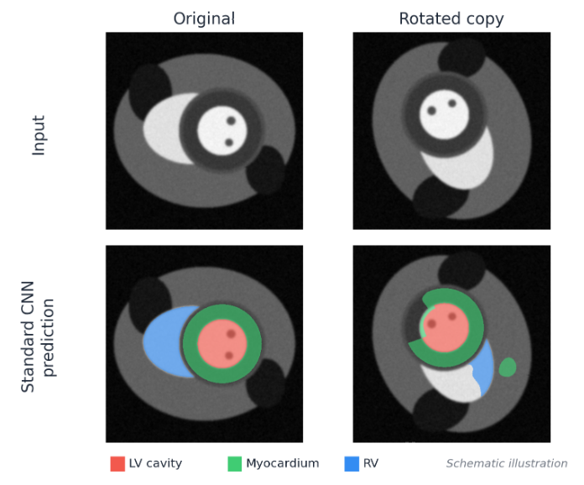
A rotated heart is still a heart
CNNs share weights across translations, not across rotations
A rotated input can give a prediction that is not the rotated output
Standard fix: rotation augmentation, so the network learns each orientation separately
That spends capacity and data, and data is what we have least of
Notes:
Live question: is a CNN rotation equivariant? Let them answer before showing the figure. Then: augmentation teaches the symmetry approximately and at a cost.

Slide 23
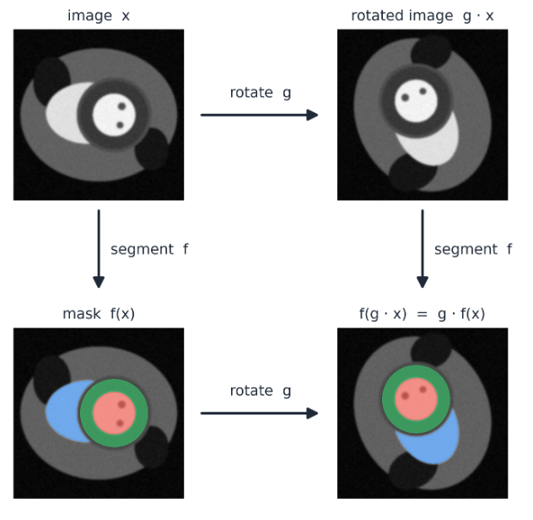
Equivariance: outputs follow inputs
f is equivariant to a group G if
f(g · x) = g · f(x) for every g in G
Segmentation should be equivariant: rotate the image and the mask rotates with it
Classification should be invariant: rotate the image and the label stays the same
SE(2) is the group of translations and rotations of the plane
Notes:
Go slowly here; this is the one formal definition in the lecture. Use the commutative diagram: both paths around the square give the same result.

Slide 24
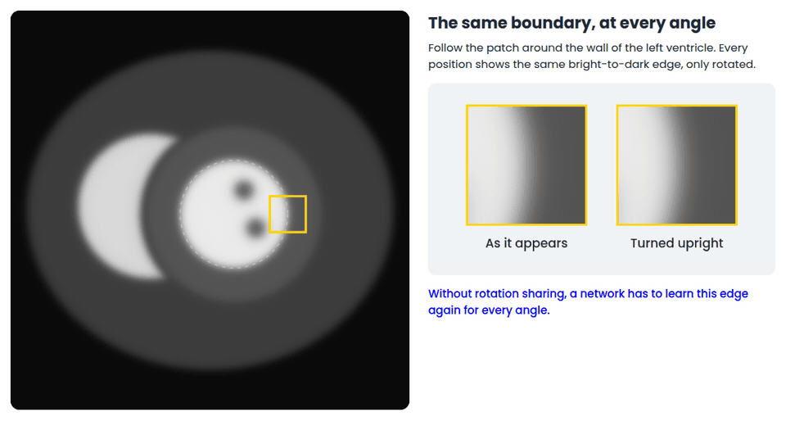
Locally, the wall is one edge, rotated
The heart as a whole has a preferred orientation in a short-axis view
Its parts do not: the ventricle wall is a ring, so its boundary runs through every angle
Each small patch of the wall is the same bright-to-dark edge, rotated
Sharing one filter over rotations uses that redundancy in every layer
Notes:
Run the demo in three steps. 1: follow the patch around the wall; turned upright it never changes. 2: an ordinary filter has one direction and only finds part of the wall. 3: the same filter at eight angles covers the wall, and rotating the image moves the response at the marked point to the next orientation channel. This answers the objection that short-axis views are already in a standard orientation: the global pose is standardised, the local geometry is not.

Slide 25
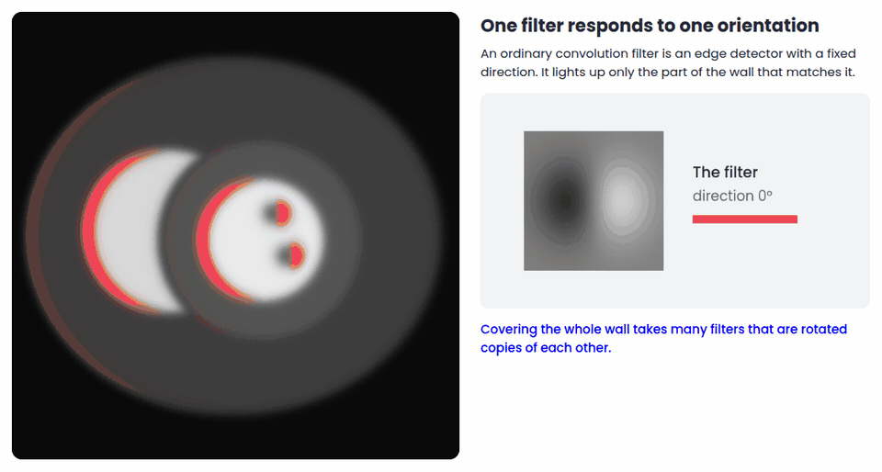
Locally, the wall is one edge, rotated
The heart as a whole has a preferred orientation in a short-axis view
Its parts do not: the ventricle wall is a ring, so its boundary runs through every angle
Each small patch of the wall is the same bright-to-dark edge, rotated
Sharing one filter over rotations uses that redundancy in every layer
Notes:
Run the demo in three steps. 1: follow the patch around the wall; turned upright it never changes. 2: an ordinary filter has one direction and only finds part of the wall. 3: the same filter at eight angles covers the wall, and rotating the image moves the response at the marked point to the next orientation channel. This answers the objection that short-axis views are already in a standard orientation: the global pose is standardised, the local geometry is not.

Slide 26
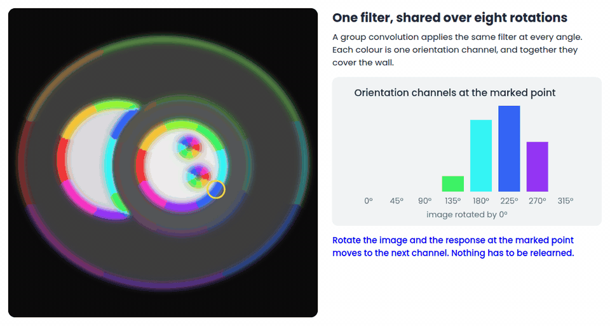
Locally, the wall is one edge, rotated
The heart as a whole has a preferred orientation in a short-axis view
Its parts do not: the ventricle wall is a ring, so its boundary runs through every angle
Each small patch of the wall is the same bright-to-dark edge, rotated
Sharing one filter over rotations uses that redundancy in every layer
Notes:
Run the demo in three steps. 1: follow the patch around the wall; turned upright it never changes. 2: an ordinary filter has one direction and only finds part of the wall. 3: the same filter at eight angles covers the wall, and rotating the image moves the response at the marked point to the next orientation channel. This answers the objection that short-axis views are already in a standard orientation: the global pose is standardised, the local geometry is not.

Slide 27
What equivariance is meant to fix
No rotation augmentation: every orientation is covered by construction
Each training image informs the network about all its rotated copies
Latents are tied to anatomy, so image and mask stay aligned
Hypothesis to test: the gain over a standard network grows as labels get fewer
Notes:
State these as expectations and show the evidence you have. If the data-efficiency curve is not final, say so and present it as the experiment that tests the claim.

Slide 28
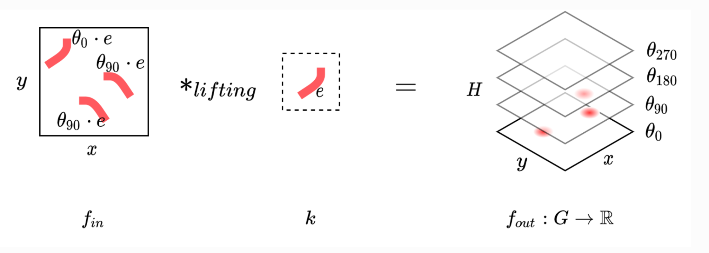
Weight sharing beyond translation
A group convolution applies each filter at every position and every rotation angle
Feature maps gain an orientation axis: (x, y, θ)
Rotating the input moves the features in a known way instead of changing them
One filter now detects a boundary in all orientations
Cohen and Welling, ICML 2016
Notes:
Ordinary convolution is the special case where the group is translations only. Group convolution repeats the same argument for rotations. The price is the extra orientation axis.

Slide 29
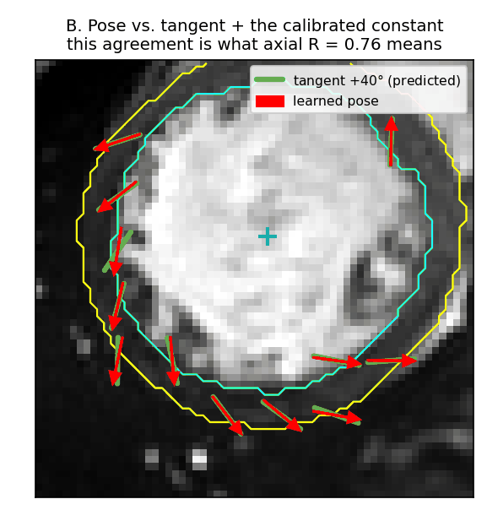
Latents with a position and an angle
Equivariant neural fields describe an image with a small set of latents
Each latent has a pose (x, y, θ) and a feature vector
The decoder attends to latents using coordinates relative to each pose
Move or rotate the latents and the decoded image moves or rotates with them
Unlike network weights, these latents say where things are
Notes:
Equivariant neural fields (Wessels et al.). Contrast with the previous approach: there the latent was a weight vector, here it is a set of points with poses that sit on the anatomy.

Slide 30
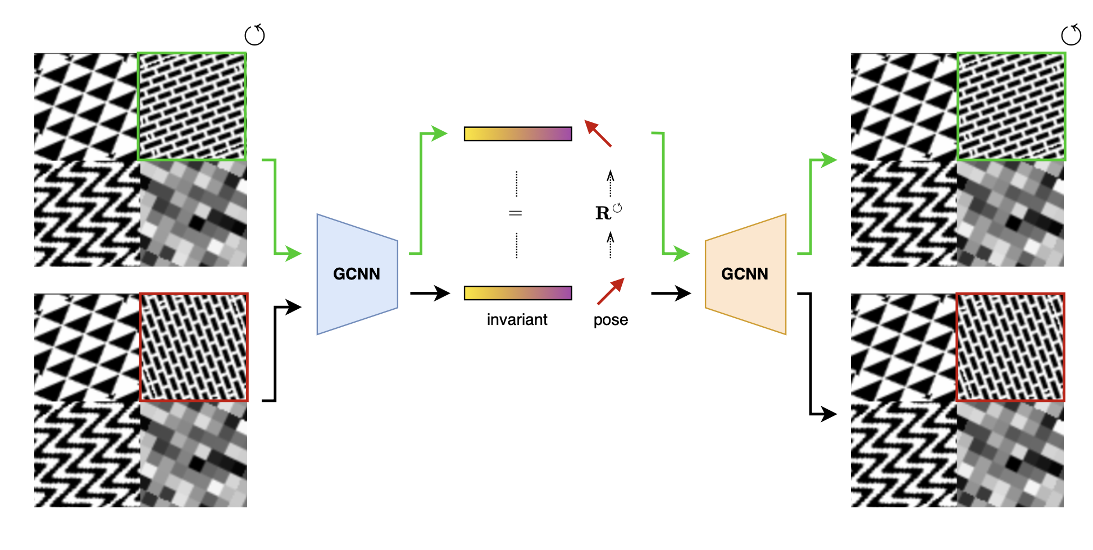
Our model for cardiac MRI
An SE(2)-equivariant group CNN encodes a slice into pose-anchored latents
A neural field decoder reconstructs the image at any resolution
A second head decodes the mask from the same latents as a signed distance field
Rotate the input and latents, image and mask rotate together
Notes:
Walk through the architecture left to right. Explain why a signed distance field is used for the mask: boundaries are defined below pixel resolution. Decide how much unpublished detail to show.

Slide 31
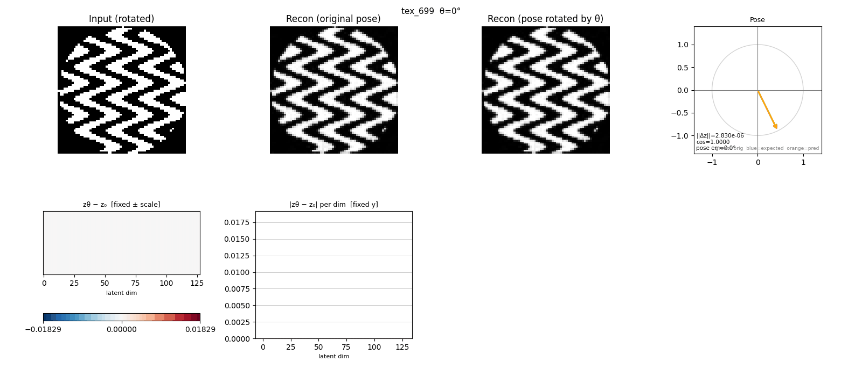

Slide 32
Where equivariance breaks or costs
It covers only the symmetries you build in: rotation and translation, not scale or deformation
Pooling, normalisation and interpolation can break it without any error message, so measure it
The orientation axis multiplies memory and compute
If scans already arrive in a standard orientation, the prior buys less
A wrong prior hurts: check that the symmetry holds in your data
Notes:
Students remember the failures. Tell the debugging stories: adaptive pooling on odd dimensions and instance normalisation breaking equivariance, found only by measuring the equivariance error. Short-axis views are roughly standardised, so ask whether rotation is the symmetry that matters most.

Slide 33
Takeaways
Before choosing an architecture, write down what you already know about the data
Periodic signal: predict on a circle. Arbitrary pose: use equivariance. Continuous anatomy: use a field
Priors help most when labels are few, which is the normal case in medical imaging
Test the prior: measure the equivariance error and compare against augmentation
How does your model interpret the data?
Notes:
Return to the table from the start. The method differs per row but the reasoning is the same. End on testing the prior: an inductive bias is a hypothesis about the data.

Slide 34
Further reading
Cohen and Welling, Group Equivariant Convolutional Networks, ICML 2016
Sitzmann et al., Implicit Neural Representations with Periodic Activation Functions, NeurIPS 2020
De Luigi et al., Deep Learning on Implicit Neural Representations of Shapes (inr2vec), ICLR 2023
Wessels et al., Grounding Continuous Representations in Geometry: Equivariant Neural Fields, 2024
Bernard et al., Deep Learning Techniques for Automatic MRI Cardiac Multi-Structures Segmentation and Diagnosis: Is the Problem Solved?, IEEE TMI 2018
Notes:
Add your own papers (CyclePhase at MIDL, the SPIE paper) with full references.

